Slide 1
Secure Data Handling in Images Using Steganography
“StealthWrite”
Presented By:
Student Name : Agastya Gaurav Pandey
College Name & Department : Graphic Era University (ME) 2018-24

Slide 2
OUTLINE
Problem Statement
Technology used
Wow factor
End users
Result
Conclusion
Git-hub Link
Future scope

Slide 3
Problem Statement
In an increasingly digital world, the need for secure communication is more critical than ever. Traditional encryption methods protect sensitive information by scrambling it, but the presence of encrypted data can be easily detected by third parties, raising suspicion and potentially compromising privacy. There is a growing need for a more covert means of communication where the very existence of the message is concealed.
“StealthWrite” aims to address this challenge by providing a robust steganographic solution to securely hide sensitive information within digital media files (such as images, audio, or video) without any noticeable alteration to the content. This project will focus on creating an easy-to-use platform that allows users to encode and decode hidden messages seamlessly, ensuring that the hidden information remains undetected by unauthorized parties.

Slide 4
Technology used
Programming Language : Python
Platform : Windows
Development Environment : IDLE (Integrated Development and Learning Environment)
Libraries Used :
OpenCV : for image processing and manipulation, specifically for embedding hidden messages within images (using techniques like least significant bit encoding).
Os : for file handling and system operations.
numpy :(optional) for efficient array handling and image data manipulation.

Slide 5
Wow factors
“StealthWrite” project, a potential wow factor could be:
Real-time encoding and decoding: A seamless user interface where messages can be hidden or revealed in images almost instantly.
Multi-layer security: Combining steganography with encryption for an extra level of privacy protection.
High-quality image preservation: The ability to hide messages in images without any perceptible loss in quality, ensuring that the hidden message remains invisible to the human eye.

Slide 6
End users
“StealthWrite” project are individuals or organizations seeking secure communication through hidden messages in digital media.
These include:
Privacy-Conscious Individuals wanting to protect personal information.
Businesses needing to securely share confidential data.
Government Agencies for covert information exchange.
Cybersecurity Enthusiasts exploring data concealment techniques.
Researchers in digital forensics or security.
Developers and Tech Enthusiasts experimenting with steganography.

Slide 7
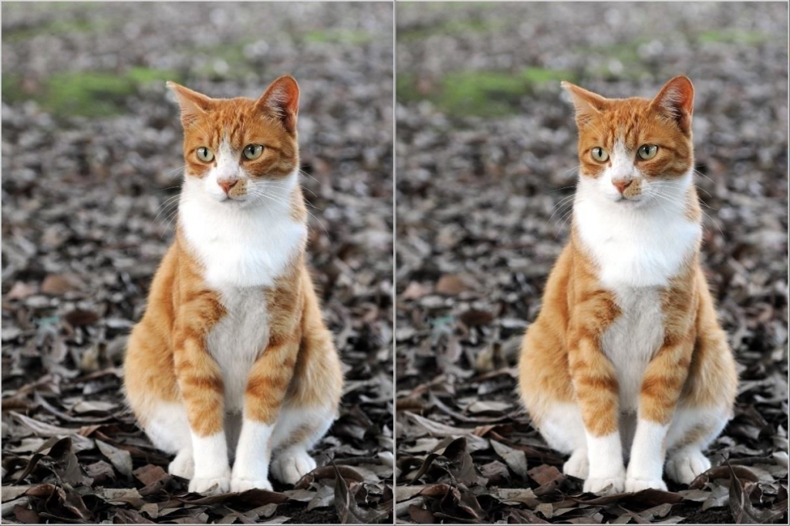
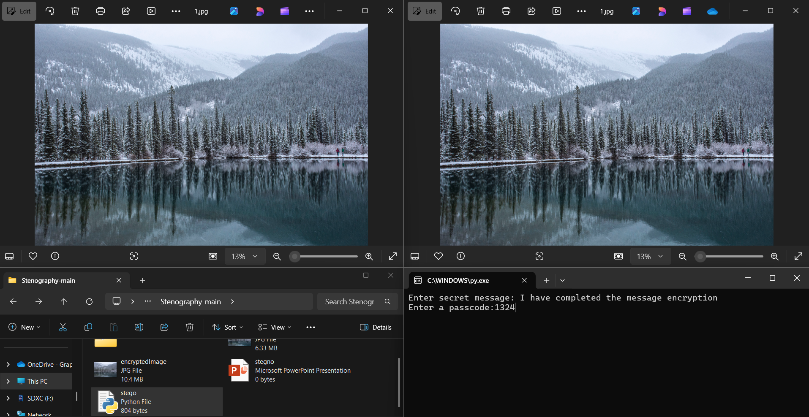
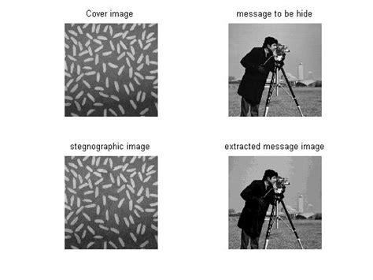
Results
Original Image
Encrypted Image
Original Image
Encrypted Image

Slide 8
Conclusion
In conclusion, “StealthWrite” offers a powerful and innovative solution for secure communication by leveraging steganography to hide sensitive information within digital media files. By utilizing Python and the OpenCV library, the project provides an easy-to-use platform for encoding and decoding hidden messages, ensuring that users can share confidential data covertly. Whether for personal privacy, corporate security, or research purposes, “StealthWrite” caters to a wide range of users who prioritize discretion and data protection. With its focus on seamless integration, user-friendliness, and effective data concealment, the project stands as a valuable tool for anyone seeking to enhance their communication privacy in the digital age.

Slide 9
GitHub Link
https://github.com/AgastyaGaurav/Image-Encryption-and-Decryption.git

Slide 10
Future scope(optional)
The future of StealthWrite includes several exciting enhancements, such as:
Multi-Format Support for hiding messages in audio, video, and text files.
Encryption Integration for added security with double-layer protection.
Real-Time Communication for live, secure message exchanges.
Detection Tools for identifying hidden messages in digital files.
Cross-Platform Support for broader accessibility (Mac, Linux, web-based).
User Authentication for secure access to encoding and decoding features.
Cloud Integration for storing and retrieving hidden messages securely.
These advancements will further enhance StealthWrite’s capabilities, making it an even more powerful tool for secure communication.

Slide 11
THANK YOU

